Slide 1
COVID-19 RAPID SURVEYS HOUSEHOLDS AND JOBS TRACKER HIGHLIGHTS OF FINDINGS FIRST EDITION OF WAVE I
PRESS RELEASE
30 July 2020
Notes:
Self explanatory

Slide 2
Scope
Context – Introduction & Methodology
Thematic results
Knowledge of COVID-19
Jobs and income
Access to basic needs
Health care
Food security
Education
Intra-Household Issues – Focus on children
Upcoming Activities
1

Slide 3
Introduction
Undeniably COVID-19 has affected livelihoods
What have been the pathways of effects?
Which categories of persons have been affect?
What has been the extent of effects?
Which underlying factors have lessened or heightened the effects?
How and to extent will the Coronavirus Alleviation Programme and other macro interventions as well as individual and households behavioural responses dampen the effects of the pandemic?
Notes:
(maybe mention that this was the first telephone survey ever done by GSS

Slide 4
Evolutions of Ghana’s COVID-19 and the Survey’s Reference Periods
Ghana COVID-19 selected experiences
March 12 - First cases of COVID-19 in Ghana
March 16 - School closure & mobility restrictions
March 30 - Partial lock down of Greater Accra & Kumasi areas
April 20 - Lifting of partial lock down
June 1 - Restrictions on selected public gatherings eased to contain 100 persons
June 22 - SHS 2&3 return to school
Survey Reference Periods
June 10-25: Field data collection
March 16: Main reference for most sections
30 days: before interview day for some sections
7 days: before interview day for some sections
3
Notes:
(maybe mention that this was the first telephone survey ever done by GSS

Slide 5
Notes on Methodology
The survey comprised two modules focusing on effects on the household as a unit (Mod. A) and intra household changes (Mod. B) with particular focus on children
Sample size was 3,265 households for Module A of which 2,063 also completed module B.
Response rate was 82 percent.
Sample was drawn from the most recent (seventh) Ghana Living Standards Survey
Sample was nationally representative covering all 16 regions of the country – responses for some regions were low
Computer Assisted Telephone Interviews was used for data collection
4

Slide 6
KEY FINDINGS FROM THE SINGLE VARIABLE ANALYSIS
5

Slide 7
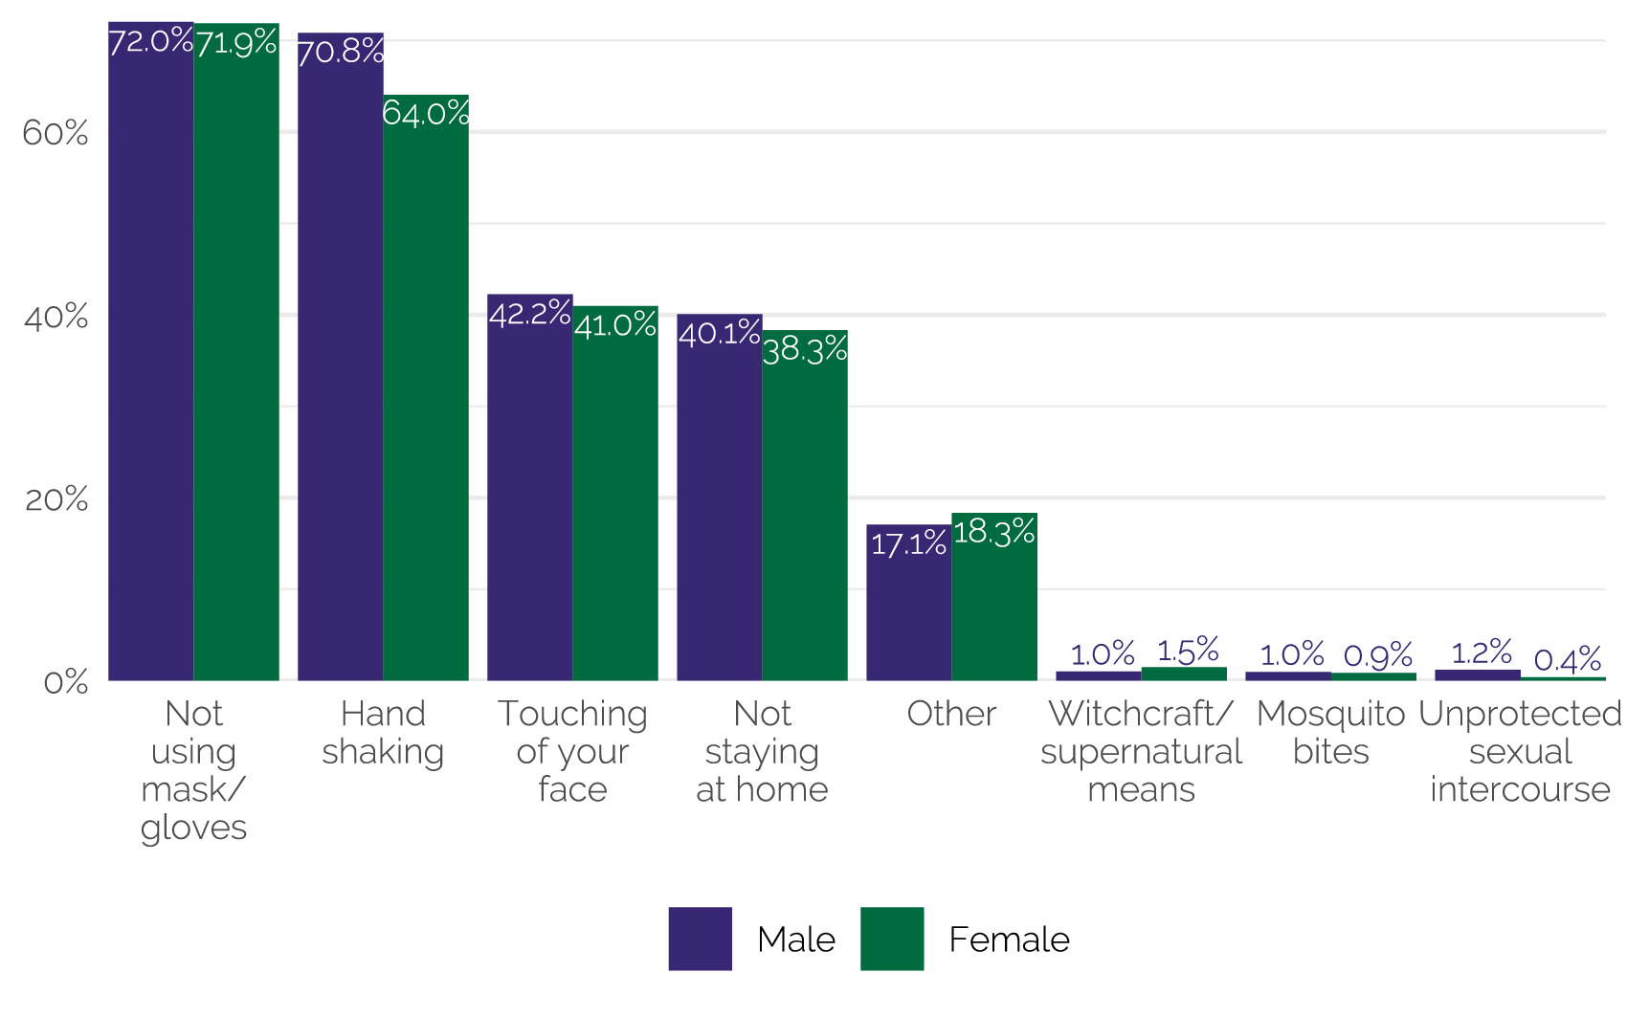
Knowledge on Modes of Transmission
Figure 1: Knowledge on mode of COVID-19 transmission by sex. Multiple responses were possible and categories were not listed to respondents
6
Notes:
Knowledge of the COVID-19 was universal, as 99.7% of the population heard of it.
When respondents were asked how someone contracts the virus.
72% indicated not using a mask/gloves.
68.5% mentioned handshaking.
Radio (83.3%) and television (79.6%) were cited as the most important sources of information for COVID-19 with television (49.2%) being the ‘most trusted source.’

Slide 8
Jobs and Income – 1\3
30.2% of respondents indicated that they had not worked in the previous seven days.
Close to two millions persons in Ghana did not work due to COVID-19 related safety concerns.
Between 3rd and 9th June 2020 more than one million persons (3.4%) in Ghana indicated that suspension of work was the reason for not working.
Nationally, 77.4% of households reported that the total household income has reduced since March 16 and 3.1% reported an increase in income.
7

Slide 9
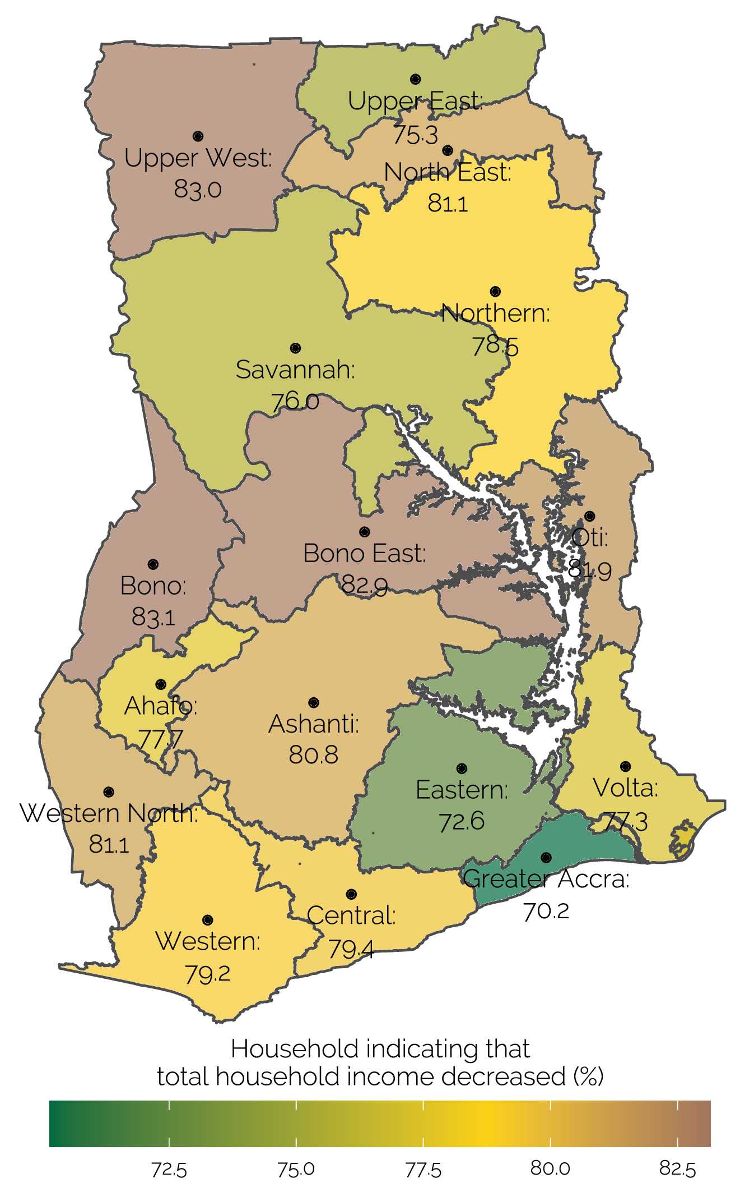
Jobs and Income – 2\3
From the perspective of reduction in incomes:
Households in all 16 regions have been affected by COVID-19
Greater Accra region recorded the least
Upper West, Bono and Bono East regions recorded the highest effects
8

Slide 10
Jobs and Income - 3\3
Among households engaged in non-farm family business 83% indicated a decrease in their income over the last 12 months
For wages, this percentage was 55%.
Figure 4: Change in household income by sources since March 16, 2020. (%) on x-axis indicates which percentage of households indicated receiving this source of livelihood in the last 12 months.
9

Slide 11
Access to Basic Needs
15.9% of households reported not being able to buy at least one staple food in the seven days prior to the survey.
Plantain had the highest non-accessibility
The main reasons for not being able to buy staple foods were the increase in price (62.7%) and lack of financial resources (19.2%).
21.1% of households reported not having regular access to water supply
17.4% reported non collection of household solid waste in the 7 days prior to the interview
10

Slide 12
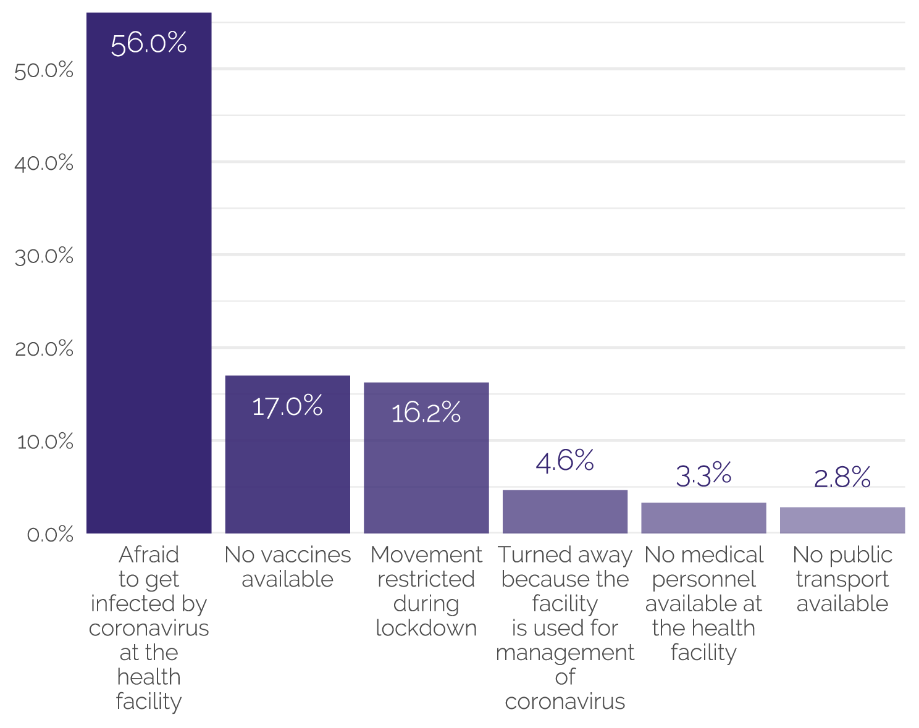
Health Care
8.6% of households could not buy medicine when they needed to.
More than 3 in every 10 children missed their vaccinations.
More than three-quarters (76.8%) of the children who missed their vaccinations, did so for COVID-19 related reasons
11
Notes:
Half (49.7%) of households with at least one child below five years indicated that the child was due for a scheduled vaccination since March 16.
While 7 out of 10 received their vaccinations,

Slide 13
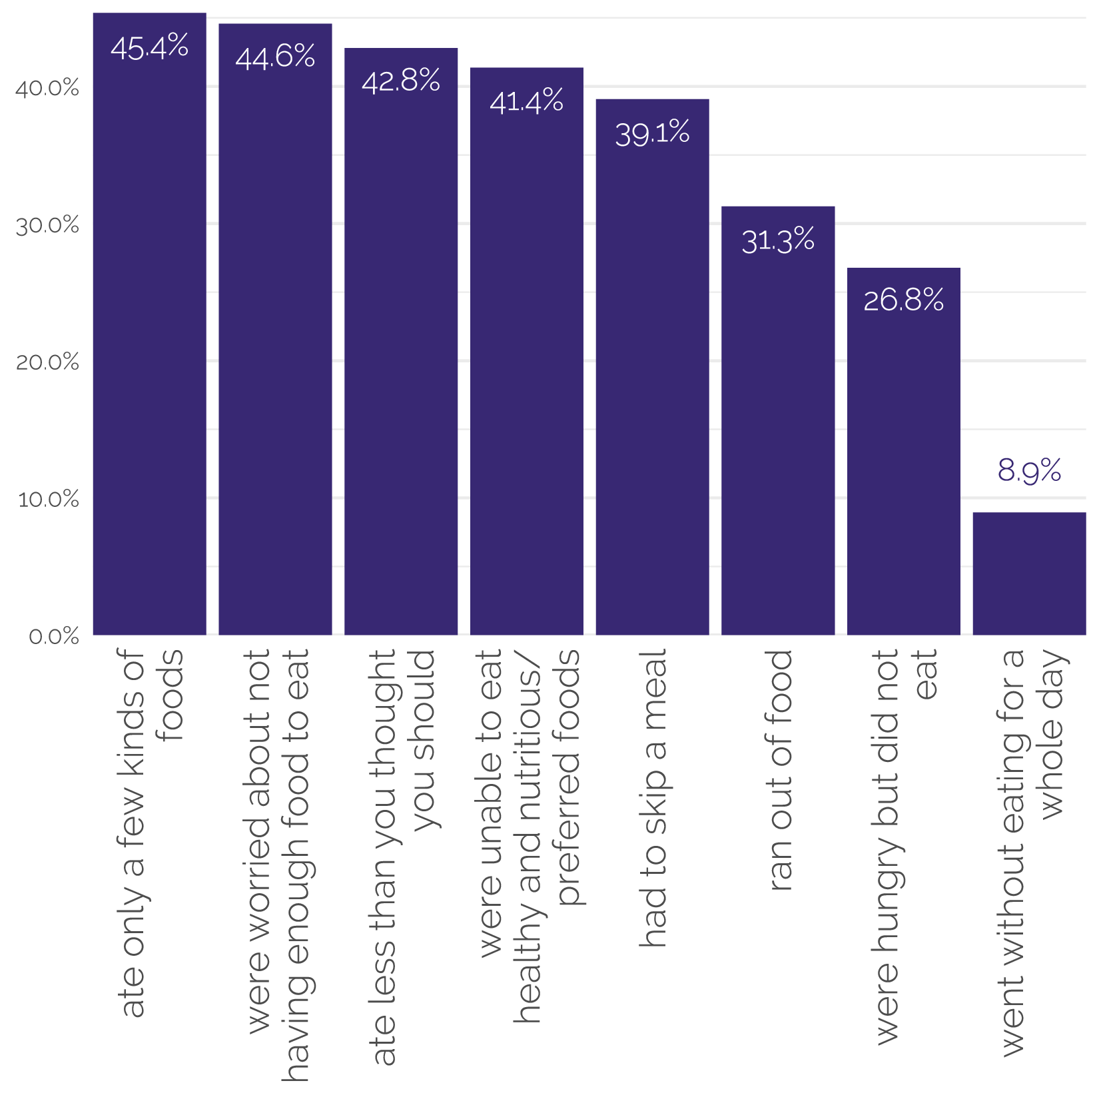
Food Security
For households with children under 15 years old, 21.4% of children ate fewer meals than usual in the past 4 weeks.
Over half (57.4%) of children 6-14 years on school feeding programmes (29.9%) still received food after schools closed.
12
Notes:
NOTE: GSS with support from FAO is computing Food Insecurity Scale based on this results to measure 2 SDGs indicators which will be made available next week.

Slide 14
Education
35% of primary and JHS pupils and 28% of SHS students are not learning anything within the period whiles at home
The most common educational programme watched by children was TV programme.
The main difficulty in the learning process that was mentioned, for both basic and SHS students, was “lack of access to basic tools like computers or phones”.
96.1% and 98.3% of households with basic school or senior high school students said children are likely to go back to school after restrictions are lifted.
Learning difficulties faced by children | Basic (%) | SHS (%)
Lack of access to internet | 14.8 | 18.4
Poor Internet connectivity | 12.2 | 15.6
Lack of access to basic tools like computers or phones | 25.6 | 32.7
Children’s lack of interest in taking learning lessons | 18.3 | 11.0
Lack of learning materials including textbooks | 21.6 | 19.8
Lack of guidance/supervision | 0.0 | 1.3
13

Slide 15
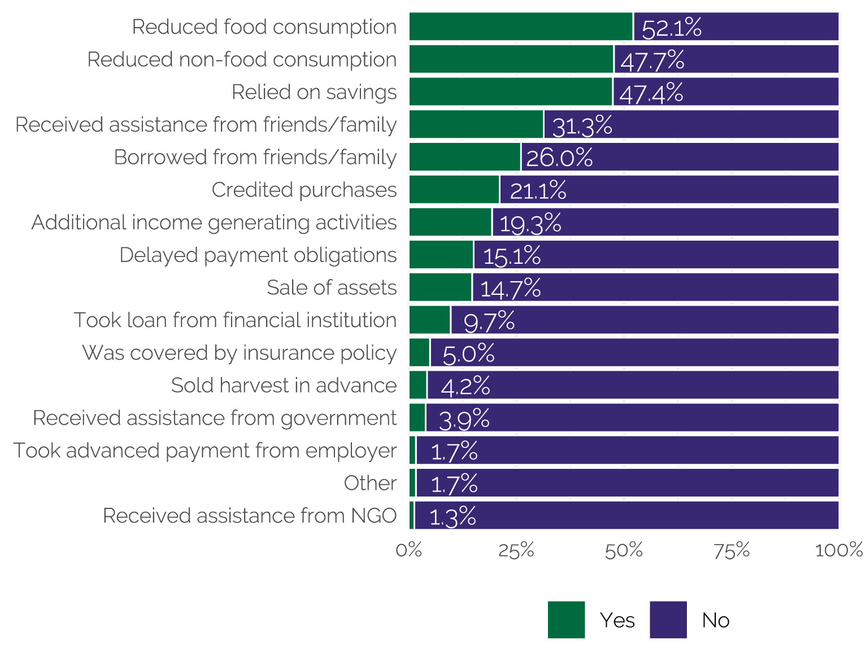
Coping Mechanisms
14
Notes:
The most common actions to cope with the effects of COVID-19 taken by households was to reduce food consumption (52.1%)
8.9% of households received at least one form of assistance from an institution (e.g. government and religious organisations), with 5.3% receiving free food.

Slide 16
Intra-Household Issues - Focus on Children
28.7% of households indicated that parents were more commonly irritated with their children.
18.1% reported an increase in physical punishment for children.
31.1% reported an increase in support received from their children regarding household chores.
10% of household reported an increase in children working or selling things for the household
Regards to violence within households, 12.9% of households agreed that their community has seen an increase in violence among members of the same household.
15

Slide 17
Highlights
About 22 million persons in Ghana were affected by reduced household income since March 16, 2020
More than one million persons (3.4%) in Ghana indicated that suspension of work was the reason for not working
The effects of COVID-19 varies across regions with a more households in Upper West and Bono regions reporting reduction in incomes
52.1% of households reduced food consumption as coping mechanism for the effects of COVID-19
More than 3 in every 10 children missed their vaccination
35.0% of basic school children and 28.0% of SHS were not engaged in any form of learning while they are at home.
The main challenge faced by children for home learning is access to basic tools such as computers or phones; 25.6% for basic school children and 32.7% for SHS children.
16

Slide 18
Upcoming Activities
A number of in-depth reports will be released soon on different thematic areas covered in the survey. Among the specific issues coming up are:
Food Insecurity
Education
Health
Income and Employment
Knowledge and Behaviour Change
Preparation underway for the Wave II of this survey to be conducted in August 2020
17

Slide 19
Thank you
For further information contact
Omar Seidu
omar.seidu@statsghana.gov.gh
0244 838054
18

